Slide 1
The Role of FinTech in Shaping Indonesia Financial Services Industry
Seminar Edukasi IndonesiaX
27 Februari 2016

Slide 2









SUPPLY: Technology is redefining the art of possible; as a result, barriers to entry are being reduced
BIG DATA
SHIFT TO THE CLOUD
SOCIAL, LOCAL, MOBILE
Personalized lifetime relationships with retail & services
Real-time data-driven decision making
Low-powered devices utilizing scalable processing, Storage & Software as a Service
Proximity and social connections create highly targeted social and commercial opportunities
UBIQUITOUS CONNECTIVITY
EXPONENTIALLY IMPROVED DEVICE PERFORMANCE
NEW DEVICE FORM FACTORS
Always on high-speed broadband on mobile connections enable other trends
Miniaturization and low power consumption combined with faster devices
“Smarter” objects allow for ecosystem development with apps and cloud services
NEW DEVICE INTERACTION MODELS
AUGMENTED REALITY
COGNITIVE COMPUTING
Ability to interface with technology through and voice commands
New device and display technologies enable visual layer of information overlaid on everyday sight
Intelligent “Al-like” personalities are able to perform complex tasks and offer nuanced recommendations
Barriers to entry is much lower than they used to be

Slide 3





DEMAND: Customers now expect and demand higher levels of convenience with bigger security
ACCESSIBILITY
TRANSPARENCY
SIMPLICITY
CUSTOMISATION
EASE OF USE
Access to information, customer service and transactions anytime and anywhere
Digital channels becoming preferred; especially mobile
Seamless omnichannel access
Authorization and transaction integrating new security features (e.g., biometrics)
Transparent pricing, service levels and terms as expected standard
Online research before purchasing common practice nowadays
Ability to share bank experience on social forums and follow peer recommendations
E-marketplaces provide product comparisons and user reviews
Reduced steps or ‘clicks’ to perform a task or accomplish an objective
Recurrent tasks automated to avoid unnecessary work
Lean processes for purchases and services
End to end processes possible over the same channel, allowing remote authorizations and document signing
Products and services targeted to customer’s specific habits and needs
Advanced analytics and new sources of information to improve customer targeting
AI-enabled expert, tailored advice that anticipates customer needs
Intuitive interfaces that do not demand long learning processes
Responsive platforms as a relevant choosing criteria
Effortless integrated views of customers’ financial status
Automatic alerts that reduce need to constantly monitor financial activity
SECURITY
COMPLY WITH REGULATORY POLICY

Slide 4
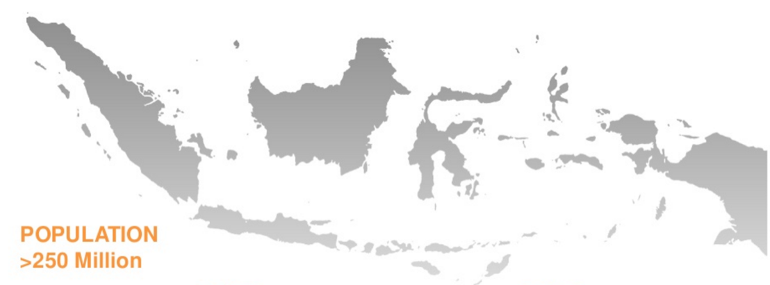
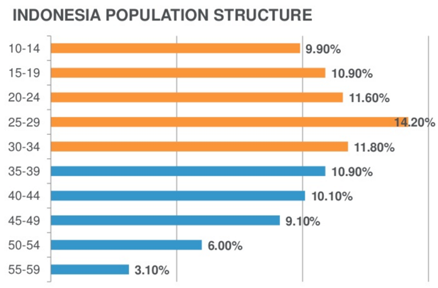
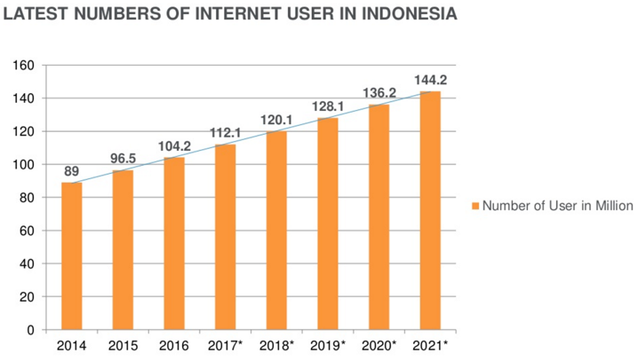
MARKET: Indonesia digital users are getting ready with SMEs playing a huge role to align with our economy’s nature
POPULATION
>250 Million
Source: Indonesia Fintech Association

Slide 5
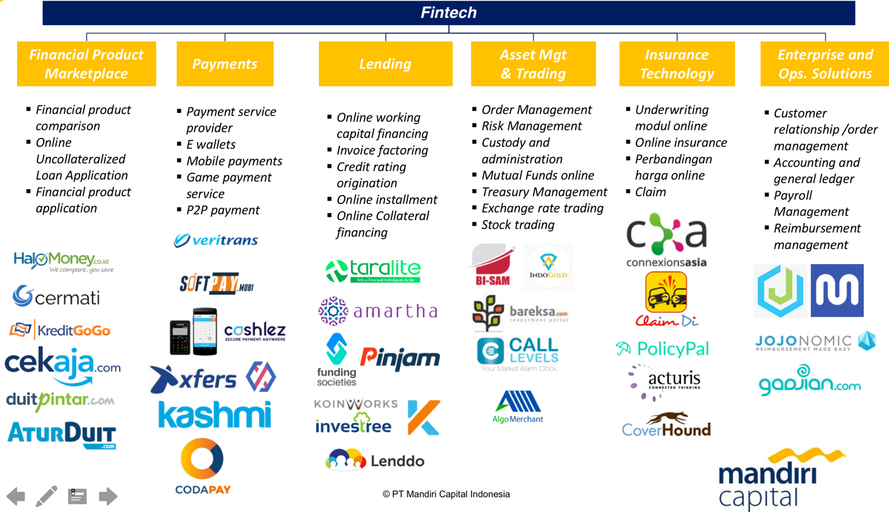
TREND: Fintech startups are mushrooming in Indonesia which bring alternatives solutions to various conventional practices

Slide 6
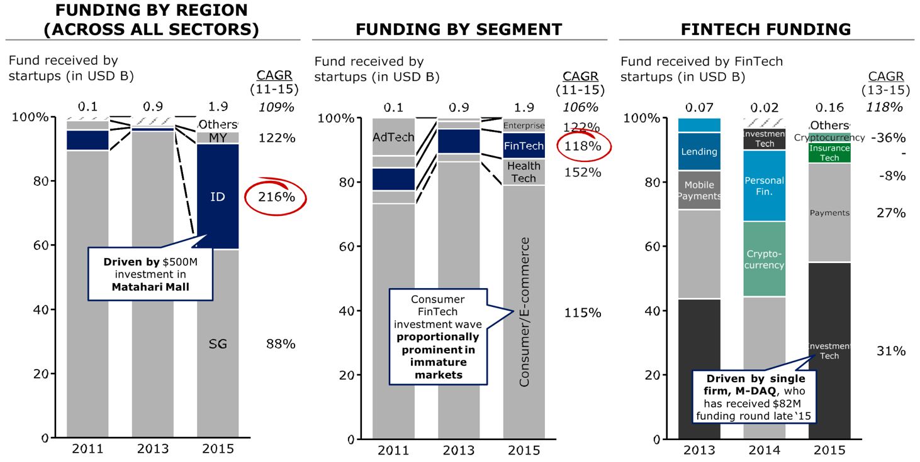
FUNDING: Indonesia funding in hyper-growth; FinTech doubling in size YoY driven by Investment Tech/ Payments
Note: Excludes startup funding rounds that are not disclosed
Source: Tracxn!; Bain analysis

Slide 7

Few segment emerged as the next innovation for financial industry which Mandiri Capital Indonesia (MCI) currently focus on
Payments
Lending
Enterprise
Technology is redefining the SUPPLY of financial product being distributed
Customers now DEMAND higher levels of convenience with bigger security
Indonesia MARKET is getting ready with digital product
Technology is the next TREND to revolutionize conventional financial practice
Startups FUNDING is in hyper-growth which FinTech doubling in size YoY

Slide 8

General Overview

Slide 9

MCI : FinTech focused Corporate Venture Capital
$40 MILLION
ASSET UNDER MGMT
20+ MILLION
END-CUSTOMERS
Mandiri Capital Indonesia (MCI) is the Corporate Venture Capital arm of Bank Mandiri, the largest integrated financial service group in Indonesia with US$80 B+ Assets, 20 M+ Retail Customers, 30 K+ outlets, and 7+ international offices.
MCI is highly strategic and agile investors predominantly within financial service industry in Indonesia by facilitating enterprise partnerships between portfolio startup and Bank Mandiri Group network of 30+ strategic subsidiaries and business units in assist startups to be the next global players.
12
DIRECT
SUBSIDIARY
COMPANIES

Slide 10

MOKA
Notable Investments and Incubatees
Amartha
Indonesia Leading m-POS
Indonesia Leading P2P Lending For Micro SMEs
Taralite
Danasedia
P2P Lending for Indonesia SMEs
Lending Leads Management
PickPack
Jurnal
LimaKilo
Packaging Solutions for online seller
Online Accounting Software for SMEs
Agriculture Product Marketplace

Slide 11
Complete go-to market access to Indonesia Market
20+ Mio
BANK
ACCOUNTS
10+ Mio
E-CHANNEL
USERS
30+ K
BRANCHLESS
AGENT
30+ K
BRANCH & ATM
OUTLETS
20+ Mio customers ranging from retail, micro, business banking, wholesale, and enterprise in Indonesia, making Bank Mandiri Group as the best go-to market partner for fintech startups

Slide 12


Synergy with Bank Mandiri Group
MCI is uniquely position to be the best partner for fintech startups to grow exponentially by leveraging Bank Mandiri Group network of strategic subsidiaries and business units within Financial service Industries.
MCI act as synergy facilitator and support system for fintech startups who want to strengthen their presence in Indonesia

Slide 13
What MCI look before investing into fintech startups? 4Ps Rules
People
Product
Potential
Performance
Mix of relevant domain experience (Finance & IT)
Capability execute the business plan
Strong motivation of the founders
Deeply understand conventional financial practice and regulation
User friendly product (both for the banked and the unbanked)
Unique differentiated features, product, or service
Localize with the needs of the target market
Enormous addressable market with huge upside potential
Unfair Advantage that will allow to beat the competition
Right timing on market readiness to adopt the product (especially to cater the unbanked)
Exponential yet healthy growth (min. 20% MoM)
Secure Stellar Growth partner (e.g. big existing conventional player) that fits with the need of the company

Slide 14
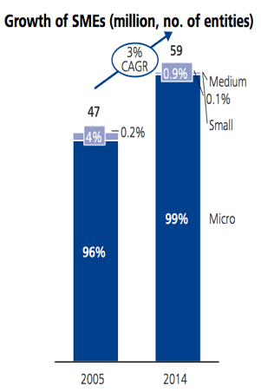
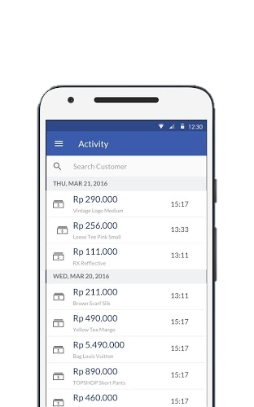
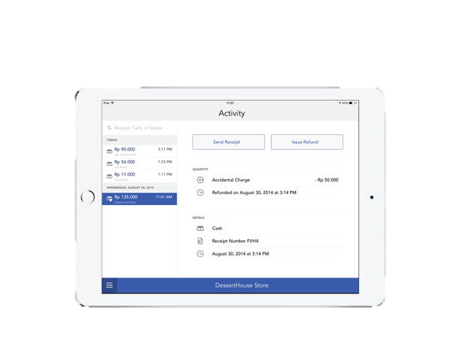
Case Study: 4P’s
People
Product
Potential
Performance

Slide 15
Website based case study
Focus on these 3 Key Category Metrics
Metrics
Conversion Status
Benchmark
FUNNEL
Unique Visit
Potential Users coming to website or platform (from various sources)
100%
Registered Users
After looking at your platform, users decide to sign up
5% - 10% (conversion)
ENGAGEMENT
Monthly/Weekly/Daily Active Users
Number of users that actively use your platform in certain time
DAU : 10%-20%
WAU : 25%-50%
MAU : 40%-60%
Churn Rate
Users that stop coming and paying at your platform
< 5%
FINANCIAL
Avg. Revenue Per User (ARPU)
Avg. revenue generated from every users
ARPU > CAC
(3x)
Customer Acquisition Cost (CAC)
Avg. cost being spent to acquire the user

Slide 16
Summary
FinTech services is gradually disrupt the conventional financial service in Indonesia to catch up with the trend of digital era
Payment, Lending, and Enterprise Solutions are the ‘low hanging’ fruits of FinTech in Indonesia
FinTech startups need more than capital to grow and educate the market while also complying with tighter regulations

